Slide 1

NEGATIVE VOLTAGE GENERATOR
Pranav Sharma 2K19/EC/126 Pranshu Gautam 2K19/EC/127

Slide 2
Negative voltage in a circuit is voltage that is more negative in polarity than the ground of the circuit. A voltage source has positive or negative polarity depending on its orientation in a circuit. In the case when a voltage source has negative voltage

Slide 3
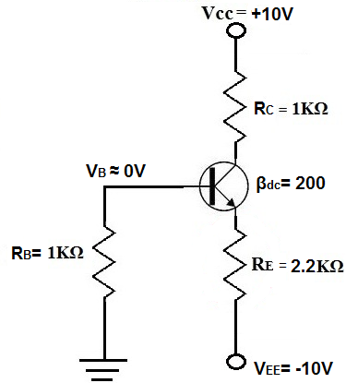
USES OF NEGATIVE VOLTAGE –
TRANSISTOR-
One example of an electronic device that many times uses negative voltage is a transistor. When a transistor is biased many times, negative voltage is placed on the transistor's emitter lead. This type of bias is called emitter bias, shown below:
When negative voltage is placed on the transistor's emitter lead, the electrons in an (NPN) transistor's emitter are repulsed from the negative voltage. Remember that in a BJT transistor, current flows out from emitter to collector. Now that the negative voltage repulses the electrons in the emitter and, thus, forces electrons to the collector, it helps to push current out from the emitter to collector.

Slide 4
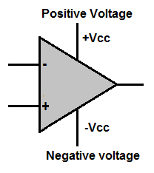
OPERATIONAL AMPLIFIERS-
Another such device that uses negative voltage is an op amp circuit, since it's composed of many transistors. Many op amps function off of a dual power supply. One lead of the op amp receives positive voltage and the other receives negative voltage.

Slide 5
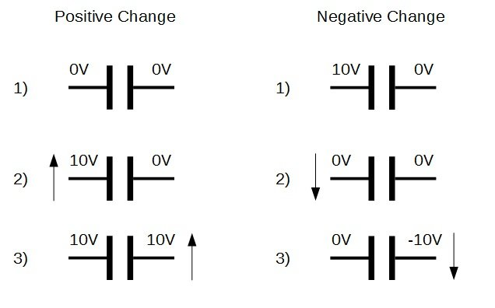
PRINCIPLES INVOLVED-
CAPACITIVE COUPLING-
Capacitive coupling is an effect where a capacitor “attempts” to keep the voltage across its terminals constant. For example, if both sides of a capacitor are at 0V and plate 1 is suddenly brought to 10V, the voltage on the other plate will immediately begin to rise to 10V. The same goes for the opposite: If the first plate is brought from 10V to 0V, then the other plate will attempt to drop by 10V to keep the voltage across the capacitor constant.

Slide 6
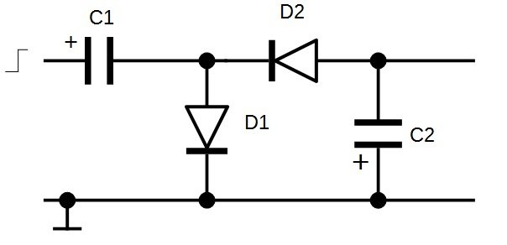
DIODES –
EXPLAINED WITH EXAMPLE-
As the input steps up from 0V to 10V, the negative plate on C1 will also try to match due to capacitive coupling. However, once the plate reaches 0.7V, D1 conducts and this prevents the plate voltage from getting higher than 0.7V. Now with the positive plate at 10V and the negative plate at 0.7V, the potential difference across the plate is 10 – 0.7 = 9.3V. When the positive plate drops rapidly from 10V to 0V, this 9.3V potential difference must be maintained due to coupling. Therefore, the negative plate drops to -9.3V. D1 cannot conduct as it is reversed biased, so this negative voltage remains on the capacitor.
D2, however, is now conducting because the anode (connected to C2 negative plate), is at a higher potential than the cathode (connected to the -9.3V). Therefore, the voltage at the negative plate of C2 will reduce until D2 stops conducting. D2 will stop conducting once the voltage drop across it becomes less than 0.7V. This will happen once the negative plate of C2 becomes -9.3 - -0.7 = -8.6V.

Slide 7
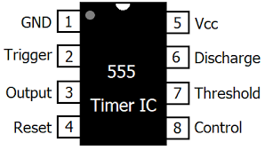
OSCILLATOR 555 IC –
An oscillator to the input is used so that a negative voltage is constantly being generated at C1, which keeps C2 topped up.

Slide 8
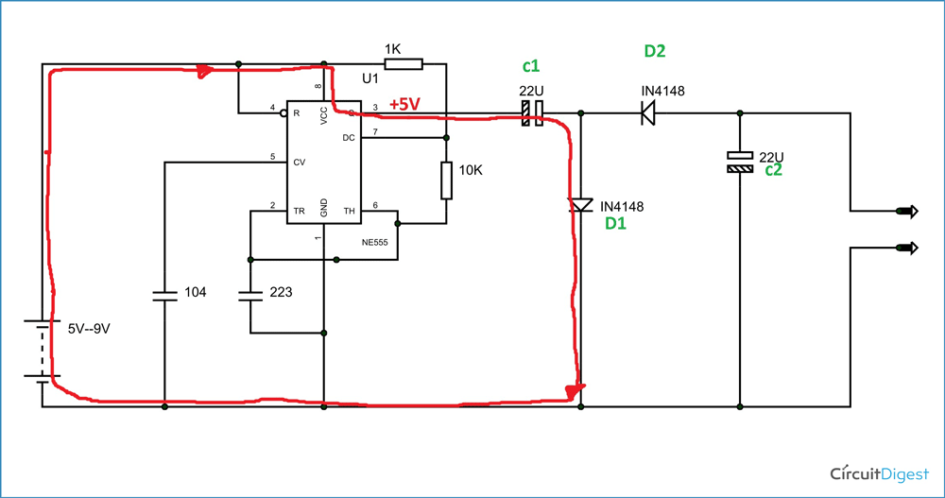
PROCESS EXPLAINED-
The 555 Timer IC acts as a square wave generator here and it generates square wave. The square will have a positive peak and +0 ground forming a complete cycle.
Now when there is a positive voltage peak at the output, there will be a current flow (REDLINE) as shown in figure below. During this time, the diode D1 will be forward biased and the diode D2 will reverse biased.
Because of this the capacitor C1 gets charged as shown in figure, and a voltage VCC appears across

Slide 9
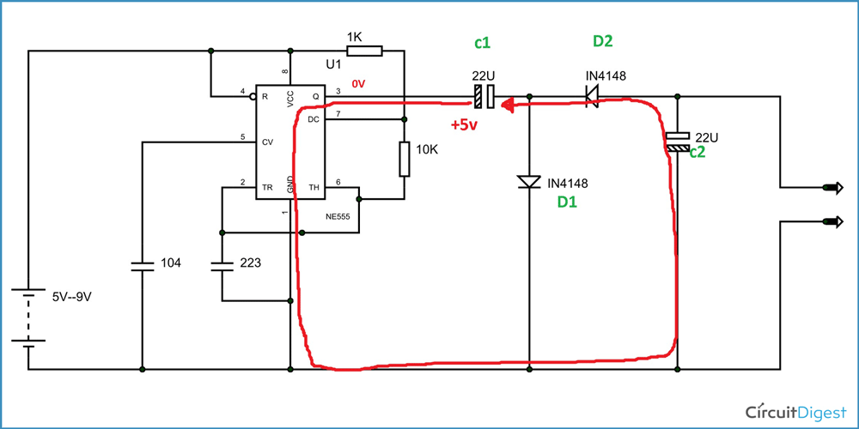
Now when ground appears after positive peak, there will be a current flow (RED LINE) as shown in figure below. During this time diode D1 will be reverse biased and diode D2 will be forward biased. With D2 being forward biased, the charge stored in capacitor C1 will have a way to flow. So the capacitor C1 discharges through D2, along the way it charges the capacitor C2. This is shown in figure.

Slide 10
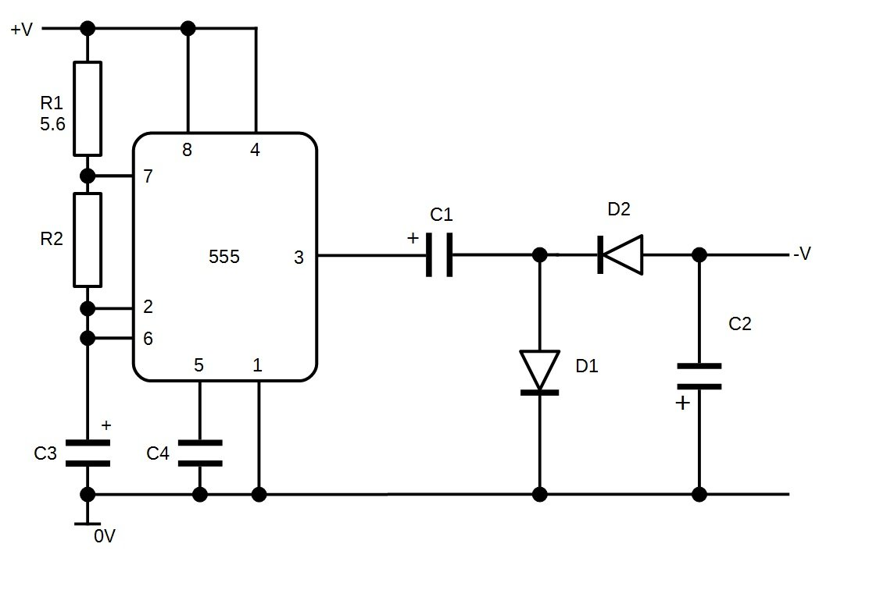
The voltage appeared across C2 will be of negative sign where referred to ground. This charging and discharging continuous with every cycle and there will be stable negative voltage across output with respect to ground.
Simplified circuit diagram-

Slide 11
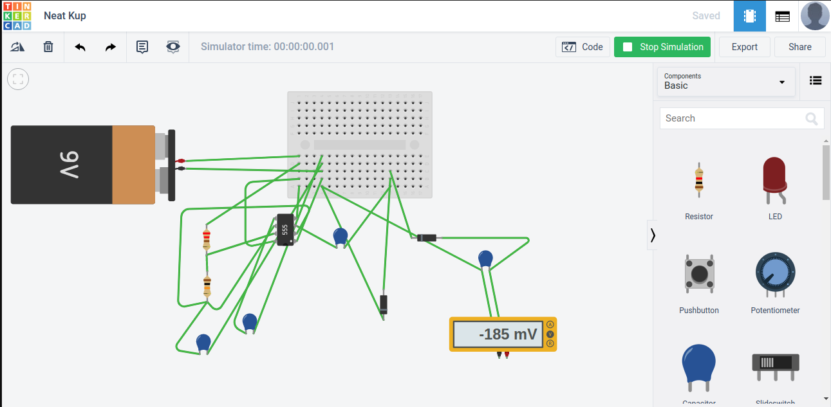
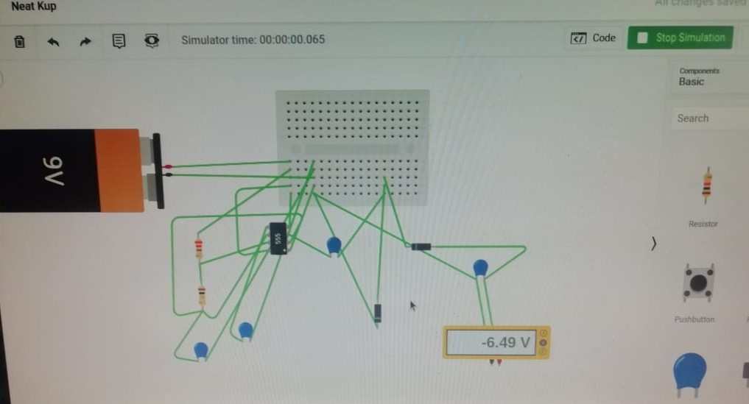
Schematic [Tinker cad]

Slide 12
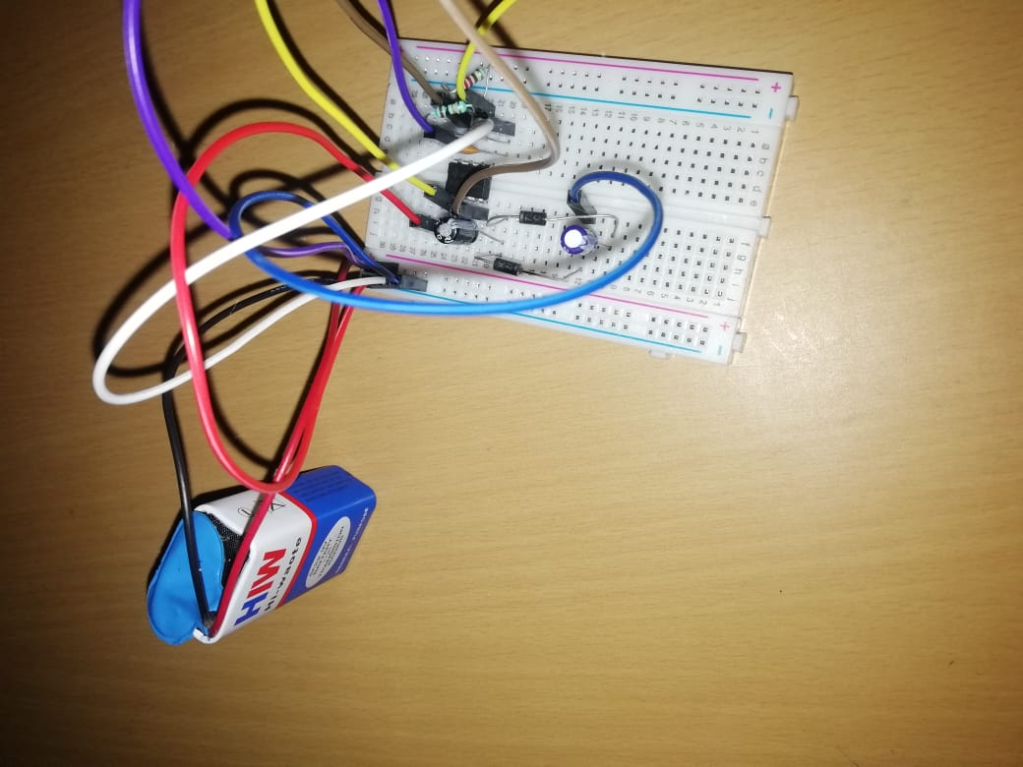
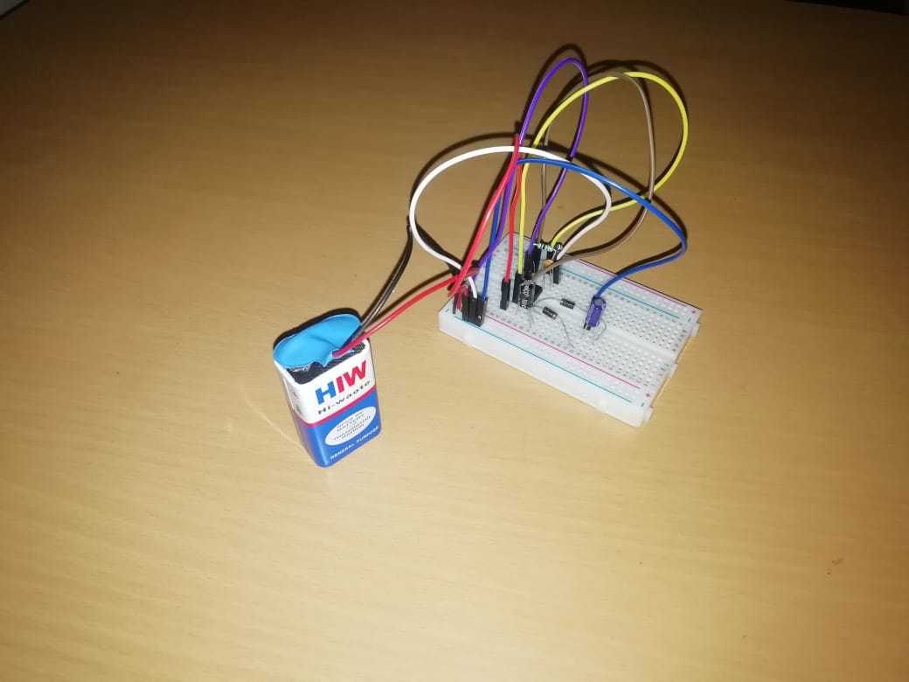
Hardware Implementation
Negative Voltage Generator Circuit

Slide 13
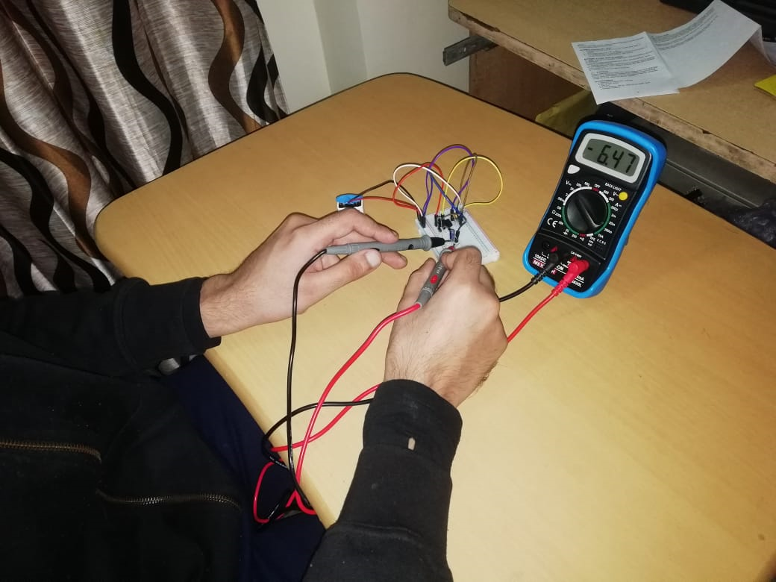
Voltage generator with multimeter reading

Slide 14
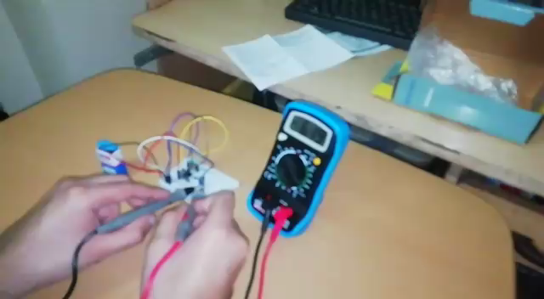
Voltage generator with multimeter reading

